Slide 1




Sharper Focus : GoPro’s Path to Renewal
By Fake Archegos Capital
FINA6215: Business Turnarounds
08/14/2024
“How could having a market-defining first mover with Silicon Valley’s beloved growth be worth so little?”

Slide 2
THIS PRESENTATION IS FOR DISCUSSION AND INFORMATIONAL PURPOSES ONLY. THE VIEWS EXPRESSED HEREIN REPRESENT THE OPINIONS OF A GROUP OF STUDENTS OF NORTHEASTERN UNIVERSITY CURRENTLY ENROLLED IN THE FINA 6215 BUSINESS TURNAROUNDS COURSE (“PRESENTING GROUP”) AS OF THE DATE HEREOF. THE PRESENTING GROUP RESERVES THE RIGHT TO CHANGE OR MODIFY ANY OF ITS OPINIONS EXPRESSED HEREIN AT ANY TIME AND FOR ANY REASON AND EXPRESSLY DISCLAIMS ANY OBLIGATION TO CORRECT, UPDATE OR REVISE THE INFORMATION CONTAINED HEREIN OR TO OTHERWISE PROVIDE ANY ADDITIONAL MATERIALS. ALL OF THE INFORMATION CONTAINED HEREIN IS BASED ON PUBLICLY AVAILABLE INFORMATION WITH RESPECT TO GoPro Inc.(“GoPro” OR THE “COMPANY”, OR THE “FIRM”), INCLUDING FILINGS MADE BY THE COMPANY WITH THE SECURITIES AND EXCHANGE COMMISSION (“SEC”) AND OTHER SOURCES, AS WELL AS THE PRESENTING GROUP’S ANALYSIS OF SUCH PUBLICLY AVAILABLE INFORMATION. THE PRESENTING GROUP HAS RELIED UPON AND ASSUMED, WITHOUT INDEPENDENT VERIFICATION, THE ACCURACY AND COMPLETENESS OF ALL DATA AND INFORMATION AVAILABLE FROM PUBLIC SOURCES, AND NO REPRESENTATION OR WARRANTY IS MADE THAT ANY SUCH DATA OR INFORMATION IS ACCURATE. NO REPRESENTATION, WARRANTY OR UNDERTAKING, EXPRESS OR IMPLIED, IS GIVEN AS TO THE RELIABILITY, ACCURACY, FAIRNESS OR COMPLETENESS OF THE INFORMATION OR OPINIONS CONTAINED HEREIN, AND THE PRESENTING GROUP AND EACH OF ITS TEAM MEMBERS, REPRESENTATIVES AND AGENTS EXPRESSLY DISCLAIM ANY LIABILITY WHICH MAY ARISE FROM THIS PRESENTATION AND ANY ERRORS CONTAINED HEREIN AND/OR OMISSIONS HEREFROM OR FROM ANY USE OF THE CONTENTS OF THIS PRESENTATION. EXCEPT FOR THE HISTORICAL INFORMATION CONTAINED HEREIN, THE INFORMATION AND OPINIONS INCLUDED IN THIS PRESENTATION CONSTITUTE FORWARD-LOOKING STATEMENTS, INCLUDING ESTIMATES AND PROJECTIONS PREPARED WITH RESPECT TO, AMONG OTHER THINGS, THE COMPANY’S ANTICIPATED OPERATING PERFORMANCE, THE VALUE OF THE COMPANY’S SECURITIES, DEBT OR ANY RELATED FINANCIAL INSTRUMENTS THAT ARE BASED UPON OR RELATE TO THE VALUE OF SECURITIES OF THE COMPANY (COLLECTIVELY, “COMPANY SECURITIES”), GENERAL ECONOMIC AND MARKET CONDITIONS AND OTHER FUTURE EVENTS. YOU SHOULD BE AWARE THAT ALL FORWARD-LOOKING STATEMENTS, ESTIMATES AND PROJECTIONS ARE INHERENTLY UNCERTAIN AND SUBJECT TO SIGNIFICANT ECONOMIC, COMPETITIVE, AND OTHER UNCERTAINTIES AND CONTINGENCIES AND HAVE BEEN INCLUDED SOLELY FOR ILLUSTRATIVE PURPOSES. ACTUAL RESULTS MAY DIFFER MATERIALLY FROM THE INFORMATION CONTAINED HEREIN DUE TO REASONS THAT MAY OR MAY NOT BE FORESEEABLE. THERE CAN BE NO ASSURANCE THAT THE COMPANY SECURITIES WILL TRADE AT THE PRICES THAT MAY BE IMPLIED HEREIN, AND THERE CAN BE NO ASSURANCE THAT ANY OPINION OR ASSUMPTION HEREIN IS, OR WILL BE PROVEN, CORRECT. THIS PRESENTATION AND ANY OPINIONS EXPRESSED HEREIN SHOULD IN NO WAY BE VIEWED AS ADVICE ON THE MERITS OF ANY INVESTMENT DECISION WITH RESPECT TO THE COMPANY, COMPANY SECURITIES OR ANY TRANSACTION. THIS PRESENTATION IS NOT (AND MAY NOT BE CONSTRUED TO BE) LEGAL, TAX, INVESTMENT, FINANCIAL OR OTHER ADVICE. EACH RECIPIENT SHOULD CONSULT THEIR OWN LEGAL COUNSEL AND TAX AND FINANCIAL ADVISERS AS TO LEGAL AND OTHER MATTERS CONCERNING THE INFORMATION CONTAINED HEREIN. THIS PRESENTATION DOES NOT PURPORT TO BE ALL-INCLUSIVE OR TO CONTAIN ALL OF THE INFORMATION THAT MAY BE RELEVANT TO AN EVALUATION OF THE COMPANY, COMPANY SECURITIES OR THE MATTERS DESCRIBED HEREIN. THIS PRESENTATION DOES NOT CONSTITUTE (AND MAY NOT BE CONSTRUED TO BE) A SOLICITATION OR OFFER BY THE PRESENTING GROUP OR ANY OF ITS TEAM MEMBERS, OFFICERS, EMPLOYEES, REPRESENTATIVES OR AGENTS TO BUY OR SELL ANY COMPANY SECURITIES OR SECURITIES OF ANY OTHER PERSON IN ANY JURISDICTION, OR A SOLICITATION OF A PROXY WITHIN THE MEANING OF APPLICABLE LAWS, AND ACCORDINGLY, COMPANY SHAREHOLDERS ARE NOT BEING ASKED TO GIVE, WITHHOLD OR REVOKE A PROXY. THIS PRESENTATION DOES NOT CONSTITUTE FINANCIAL PROMOTION, INVESTMENT ADVICE OR AN INDUCEMENT OR ENCOURAGEMENT TO PARTICIPATE IN ANY PRODUCT, OFFERING OR INVESTMENT OR TO ENTER INTO ANY AGREEMENT WITH THE RECIPIENT. NO AGREEMENT, COMMITMENT, UNDERSTANDING OR OTHER LEGAL RELATIONSHIP EXISTS OR MAY BE DEEMED TO EXIST BETWEEN OR AMONG THE PRESENTING GROUP AND ANY OTHER PERSON BY VIRTUE OF FURNISHING THIS PRESENTATION. MEMBERS OF THE PRESENTING GROUP DO NOT CURRENTLY BENEFICIALLY OWN AND/OR HAVE AN ECONOMIC INTEREST IN AND MAY IN THE FUTURE BENEFICIALLY OWN AND/OR HAVE AN ECONOMIC INTEREST IN, COMPANY SECURITIES.

Slide 3
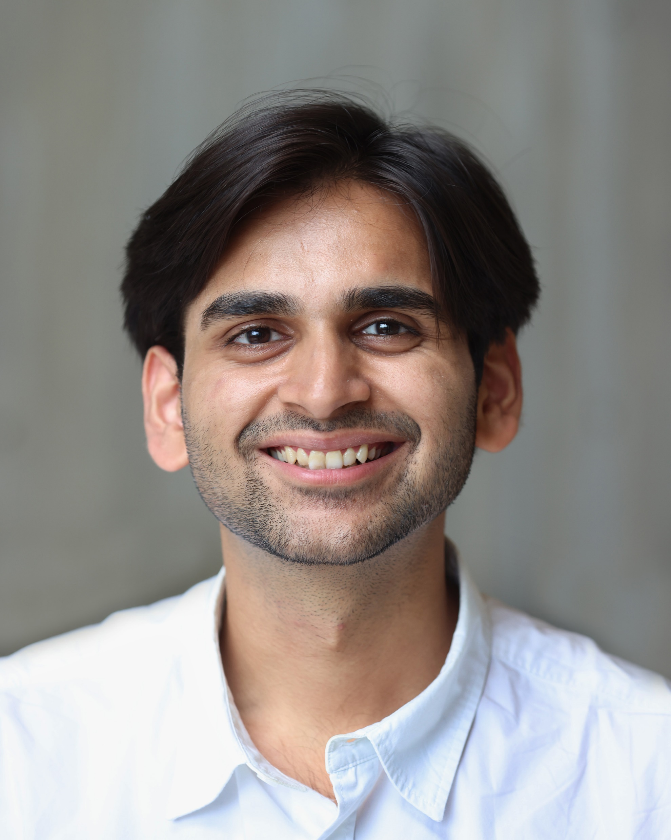



About Fake Archegos Capital Inc.
Founded in 2024, Fake Archegoes Capital hopes to be a multi-billion dollar investment management firm that focuses on investing in high-quality companies with substantial long-term growth potential. We partner closely with management teams and boards to refine strategies, enhance operations, and unlock value creation opportunities.
Our People
Karan Ravani
Principal
Karan D. Ravani has been part of Fake Archegos Capital since 2024, he joined the firm while studying the best course known to man, Business Turnaround, for his Master’s. He was previously part of a boutique firm which specialized in independent valuation advisory for IPOs, he is also an intern at City of Boston, doing budget for the city.
Vatsal Shah
Principal
Vatsal Shah joined Fake Archegos Capital in 2024 while pursuing a Business Turnaround course for his Master’s degree. Previously, he was with Morningstar Inc., where he optimized core equity data and standardized profitability metrics to support informed investment decisions.
Prachi Thakar
Principal
Prachi Rupesh Thakar has been part of Fake Archegos Capital since 2024, she joined the firm while doing a course in Business Turnaround for her Master’s degree. she was previously part of Singularity furniture Pvt. Ltd. Where she specialized in budget and sales receivable to contribute to equity utilization decisions.

Slide 4
Background
Blitzscaling
Speed and Product is everything
Become first mover
Burn millions at the cost of margins
Digital Camera
Defined by Sony, Nikon, Canon
Reduced to scraps due to
smartphones
GoPro Hero Launched
Source: Statista

Slide 5

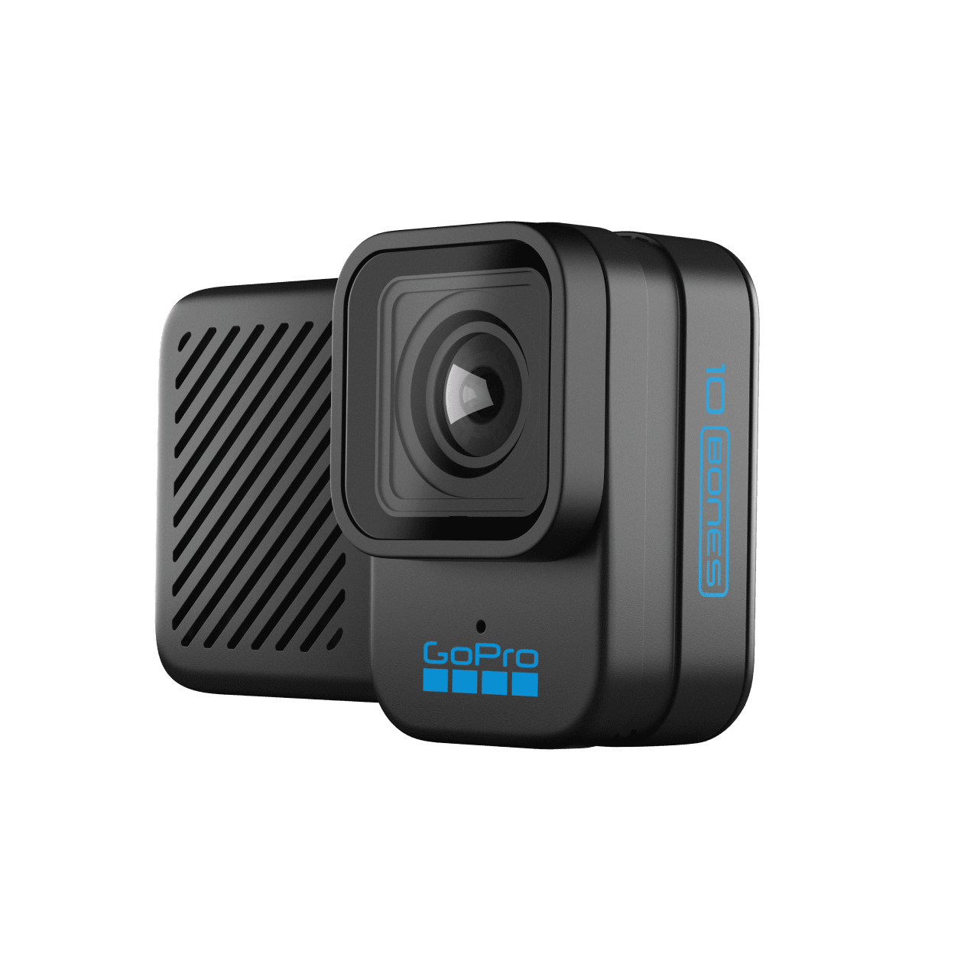
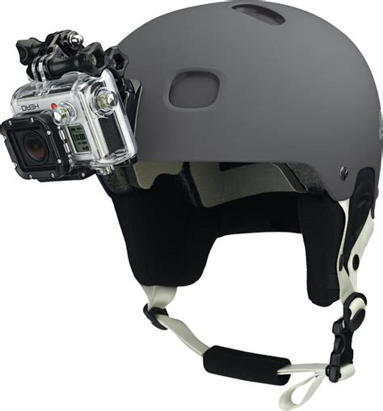
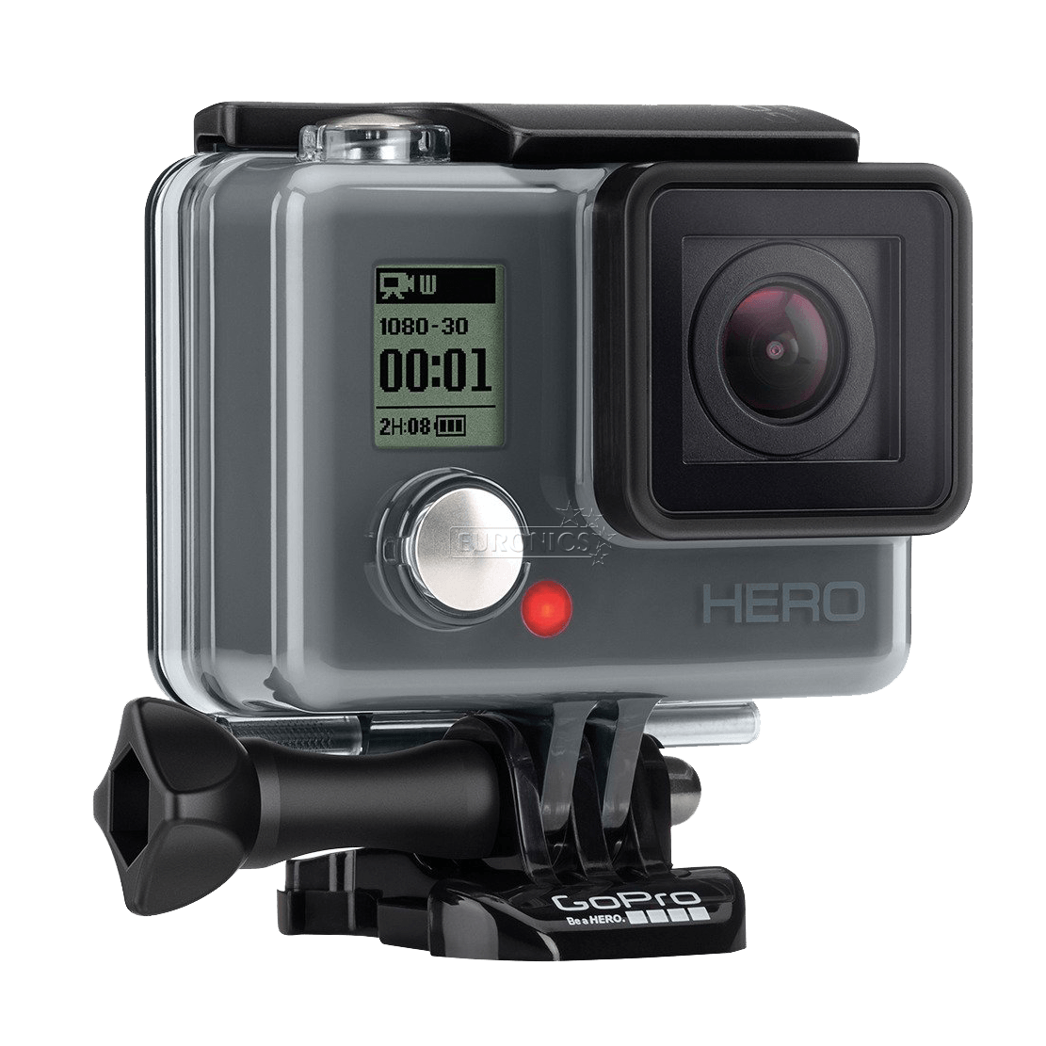
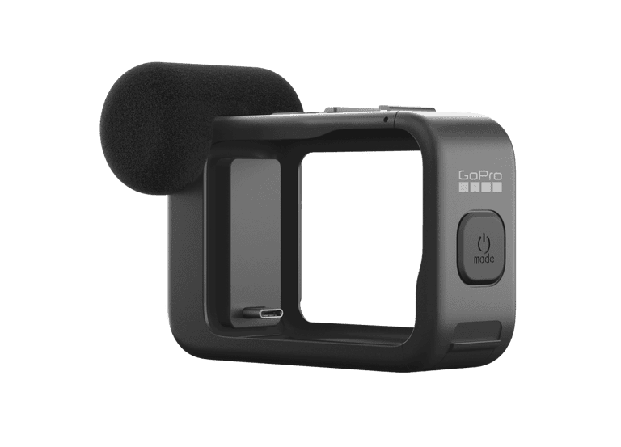
GoPro, once a trailblazer in action cameras and a household name, has struggled to maintain its market dominance. Despite the brand's strong recognition and the growing popularity of content creation, GoPro’s stock has significantly underperformed.
10K Highlights
Financials
In 2023, GoPro earned $1.0 billion in revenue (down 8% YOY), sold 3 million cameras (up 6% YOY), and grew its subscriber base to over 2.5 million (up 12% YOY), generating $97 million (up 18% YOY) from subscriptions. The company repurchased $40 million in stock and $50 million in convertible notes.
~$183M
~$180M
Market Cap
Enterprise Value
~$1bn
~$128M
Revenue
Total Debt
~$233MM
Potential
+53%
Cash
Share price
1.2
Sharper Focus : Three Angles for a perfect picture
1
Enhancing leadership and oversight
CEO Discipline, Management Overhaul
2
Monetizing trapped value of older generational products
Leasing Strategy
3
Streamlining the product-line for generational leap
Delayed Launches, Products in Adjacent Market

Slide 6
Timelines
2005
Hero 35mm: 13-Apr-05
2010
Hero LED: 25-Jan-10
Hero 960: 6-Aug-10
2011
Hero2: 24-Oct-11
2012
Hero3 (Black, Silver, White): Oct-12
2013
Hero3+ (Black, Silver): Oct-13
2014
Hero4 (Black, Silver, Session): Sep-14
Hero: Sep-14
2015
Hero+LCD: Jun-15
Hero+: Oct-15
2016
Hero5 Black: Sep-16
Hero5 Session: Sep-16
2017
Hero6 Black: 28-Sep-17
GoPro Fusion: 24-Nov-17
2018
Hero (2018): 29-Mar-18
2019
Hero8 Black: 1-Oct-19
GoPro Max: 1-Oct-19
2020
Hero9 Black: 16-Sep-20
2021
Hero10 Black: 16-Sep-21
2022
Hero11 Black: 14-Sep-22
Hero11 Black Mini: 18-Nov-22
2023
Hero12 Black: 6-Sep-23
2024
Hero13 Black: Pending (September 2024)
2001: Ideation
2002: Refining
2003: Secures funding
2004: Debut Year
2005: It takes two
2012-13:
2014:
Nick Woodman conceives the wrist strap idea for film cameras, leading to GoPro's creation.
Woodman refines the idea during a surf trip, realizes need for a complete package of strap, camera, and casing.
$100,000 from father, $35,000 from mother, and $30,000 from personal savings.
GoPro launches the 35mm Hero; sells $150,000 worth of products by year-end, focusing on surf and sports retailers.
Hires college buddy for sales; achieves $350,000 in revenue.
2010-11:
Preferred Funding: $200MM
VC Funding- $88.21MM
IPO- $427MM

Slide 7
From Hero to Hindsight: GoPro’s Journey Through Time
The Golden Age
The Era of Doom
Dead Brand Walking
Optimism & Ambition Backed by Results
Consecutive Blunders & Misjudgments
Rearranging Chairs on the Titanic
GoPro shipment higher every year due to organic flywheel effect of awareness
Lower end in Retail, high end on Website
Partnerships (Marriot & LG)
Entertainment Division for high margin entertainment industry licenses
Locked software improvements and no discounts on previous models with minor enhancements.
Her05 and Her06 underperformed, leading to forced price cuts.
Failed entry into the DJI-dominated drone market, resulting in a quick exit and layoffs.
Entertainment and drone divisions laid off; $30M spent on severance for the entertainment division.
Shifted focus to smartphone apps, but desktop app users remained loyal; mass users content with existing tools.
CEO admitted market failures and refocused on action users.
Used the pandemic to shift to a direct-to-consumer (D2C) model, eliminating middlemen.
Developed a versatile camera with potential for other uses and adjacent markets.
Introduced two new models: Bones (for drones, from Her010) and Creator bundle (Her012 with tripod, remote, extra battery).
Explored potential in security body cams, dash cams, and baby monitors.
Acquired Forcite helmet with an integrated camera.
Raised prices despite decreasing shipments.
Considered pivoting to a software-focused business again, aiming for recurring revenue.
Took inspiration from the auto industry, treating the camera as a platform rather than a standalone product.
Pivot to subscription-based model
- 98.69%

Slide 8
Golden Age
"We see a future in which GoPro serves as a platform for people to visually express themselves like never before, a future in which their shared experiences and collective content on our platform is as valuable to GoPro as YouTube is to Google or Instagram is to Facebook. We have to enable the capture of great content, then we have to enable the easy management and editing of that content to increase the rate of sharing so that we increase the pool of content that we have.“
– Founder & CEO Nick Woodman
2010-2015
Organic growth through user generated content and word-of-mouth
“We believe our business focus results in a virtuous cycle and a self-reinforcing consumer acquisition model that fuels our growth.” - 10Q 2012
Lower-end product to regular customers in Retail (Best Buy, Target, Walmart); high end to Third Party
Installed distinct point of displays where content attracted customers
Pivot to a Media Empire?
High Margin, Supplemental income stream
Create entertainment division with flashy execs (HBO, Skype, Hulu, MTV) and 200 employees
Scour internet for GoPro footage and license
Reward creators to cold, hard CASH
Post capture editing footage software for the masses
Signs of Golden Age fading ?

Slide 9
Doom Era
"Karma has been the #2 best selling drone in North America. The problem is that as we looked towards developing the second generation of Karma, we recognized that to be competitive, the margins were going to continue to be very thin - even at a $1,000 and above price point. It became clear from the data that our customers want a more convenient, mobile-connected GoPro far more than they want a drone.“
– Founder & CEO Nick Woodman, 2018
2016-2019
Locked software improvements and refused to discount previous models with minor enhancements
Biggest improvement in data transfer with cloud subscription
Hero5 and Hero6 both sold below expectations leading to a forced price discount to $199
Entered into drone market dominated by DJI. “Being late to the party is unwise but arriving with inferiority is reckless”
Pulling out and layoff in drone division (life ~10 months)
Layoff of entertainment division with $30MM severance
Pivot to a Software Empire?
Leaning hard into smartphone apps
Powerusers laughed off and kept using desktop apps
Mass users were satisfied with existing editing tools on their smartphones
Late realization and admittance by CEO of failing market
Refocus on action users
Defined by blunders

Slide 10
Dead Brand
"Subscription is the financial engine of GoPro. It's where we make the most money. It's the fastest growing product line we've ever had that adds real value to whoever buys a camera. We're not just hardware anymore, it's now hardware and software with the software component being very profitable for GoPro.“
– Founder & CEO Nick Woodman, 2022
2020-present
Used pandemic to become a D2C brand with no middlemen
Swiss Army Knife of a camera that with some tweaks, other use-cases and repurposed for adjacent market
Two models 1) Bones: For drones from Hero10 2) Creator bundle: Hero12 with tripod, wireless remote, more battery
Potential in security body cams, dash cams, baby monitors
Acquisition of Forcite, helmet with camera
Raised prices with dwindling shipments
Pivot to a Software Empire again?
Adhering to wallstreet’s favorite recurring revenue, high-margin software company which is efficient, service-based
Inspirations from Auto industry; camera as a platform and not a standalone business
For $50, discounts on accessories, newer cameras, auto-upload, unlimited storage and insurance
Some silver linings?

Slide 11
Three Lost Angles
1
Curation Over Curation
2
Delayed Focus
3
Disrupting Workflows

Slide 12
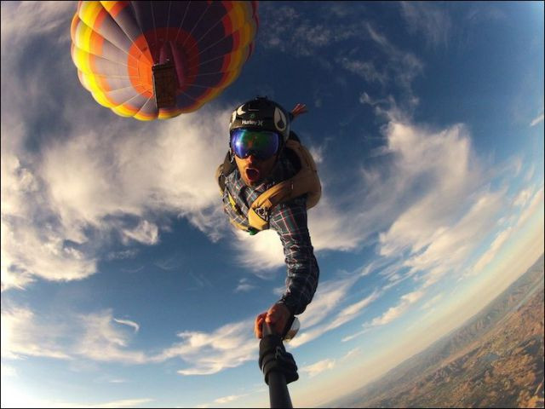
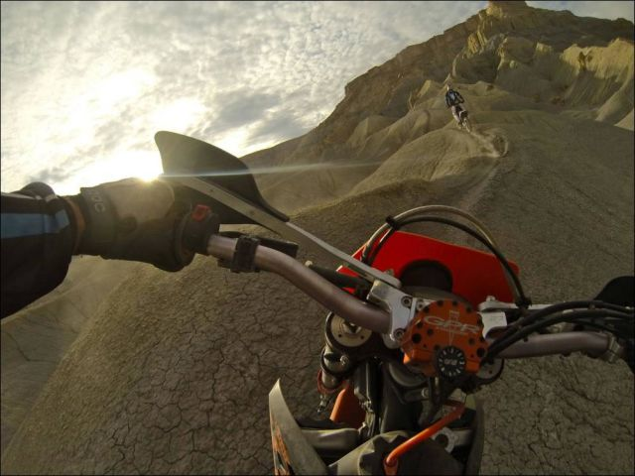


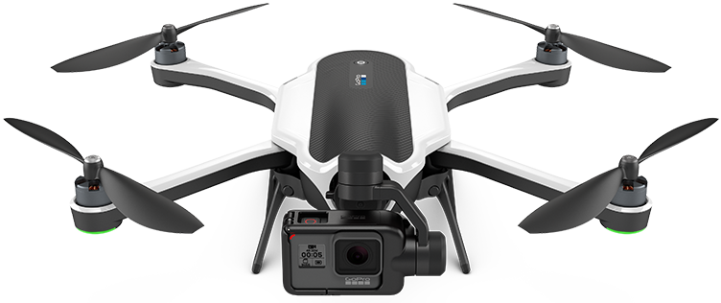
ANGLE I: Curation over Creation
Lost sight of its customers
Jumping in unproven market
What kind of company would need to license GoPro footage?
How can clip virality translate to long-form engagement?
What is second place in consumer drones worth?
How would original content sell more cameras?

Slide 13
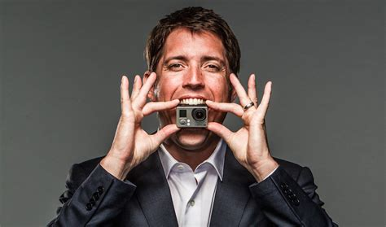
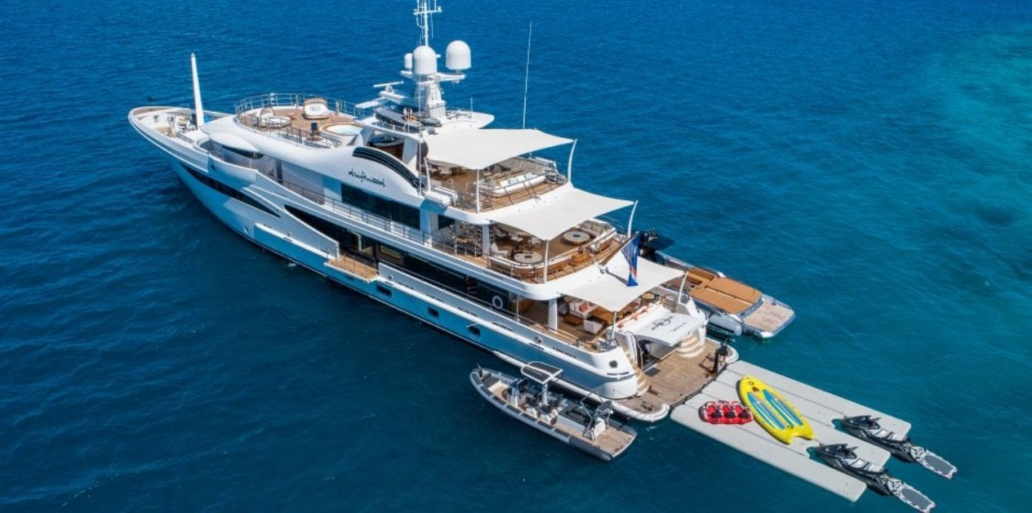

ANGLE II: Delayed Focus
Nick Woodman is the single common element across all the eras with consistent absence of urgency and intensity
Shrugs of mistake like standard business mistake
Not financially aligned with GoPro’s future
At time of IPO, bought $40MM Yacht, $20MM ranch
Highest paid CEO at $285MM ahead of Tim Cook & Bob Iger
Pricing too high, releasing too many SKUs, wrong bets are taxes for all startups, but the company made them for so long and realized only at rock bottom
Took 9 years to realize it could repurpose the camera and specialize
Some quotes by Nick Woodman;
“In the early days, we didn’t do any consumer research”
”What we’ve learned is… not everybody needs a GoPro”
Nick Woodman
Yacht
Ranch

Slide 14
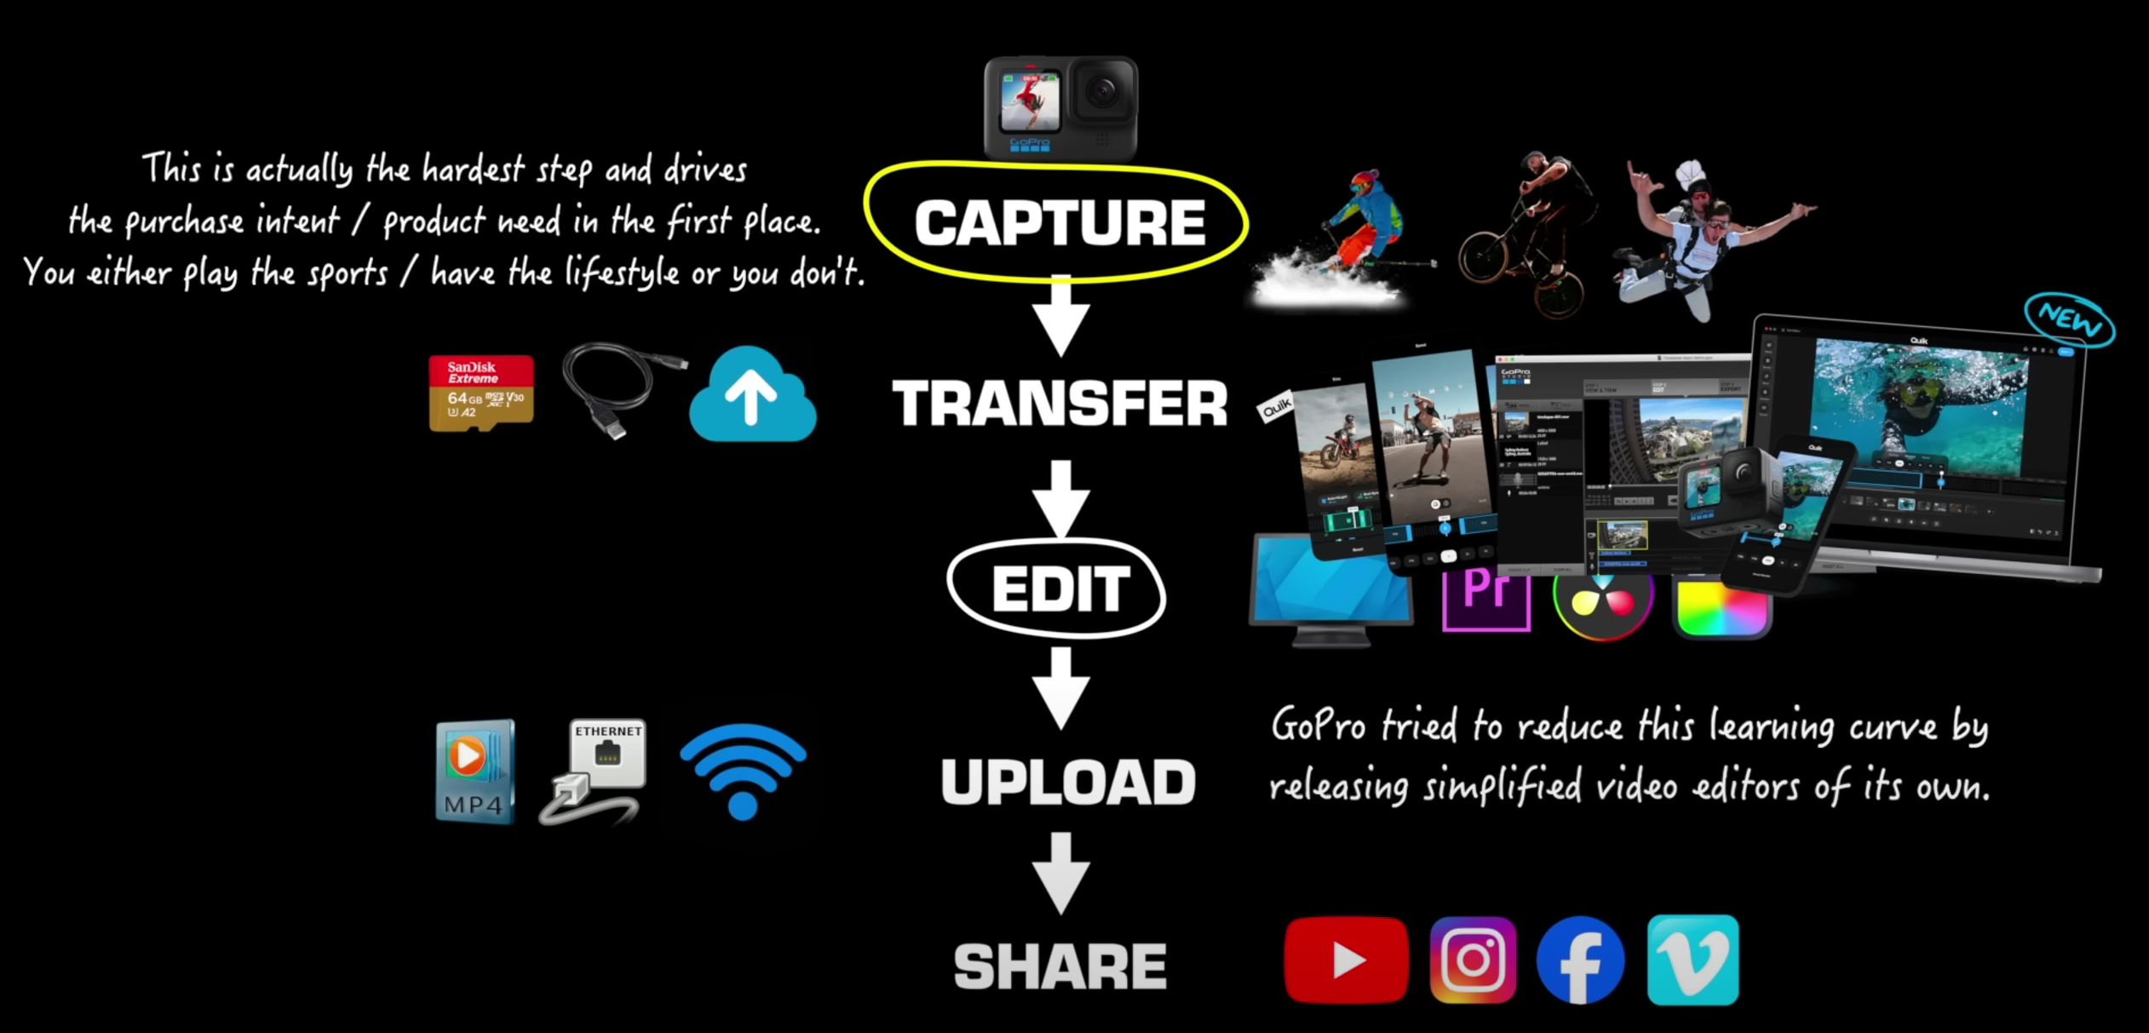
ANGLE III Disrupting Workflows
Overemphasized improving the editing experience, assuming it would drive consumer adoption
Believed that better video editors would attract everyday consumers
Misinterpreted their own workflow, overlooking the importance of content worth capturing
Failed to realize that an easier video editor doesn’t solve the issue of lacking compelling footage to edit
Modern MBA - Youtube

Slide 15
Inefficiency Framework
An analysis of outside and inside factors that led to GoPro’s poor performance
Financial
Operating
Strategic
Leadership
Financial
Operating
Peaked and Plummeted: Revenue peaked at $1.6B in 2015, but by 2023, GoPro posted a $75M operating loss with variable margins
Stock Crash Landing: Stock price dropped 97% from its $98 peak post-2014 IPO
Innovation on Pause: Product development stalled, with outdated tech and slow feature rollouts
Supply Chain Squeeze: Shortages in semiconductors disrupted production and highlighted inefficiencies
Diversification Disaster: The GoPro Karma drone flopped, leading to its withdrawal and division closure
Competition Closing In: Smartphones and competitors like DJI chipped away at GoPro's market share.
Misguided Moves: Leadership stumbled with failed media transition and unfruitful marketing
Late to Adapt: Slow to respond to consumer trends and tech changes, missing market opportunities

Slide 16
Sharper Focus
Leadership change starting with CEO who cashed out at IPO
CEO holds ~65% of voting power
Lack of strategic focus, couldn’t identify customers or TAM
Reduce compensation of the executives
In 2023,
Nick Woodman – $5.6MM
Brian McGee – $2.3MM
Eve Saltman - $1.6MM
1
Enhancing leadership and oversight
2
Monetizing trapped value of older generational products
3
Streamlining the product-line for generational leap

Slide 17
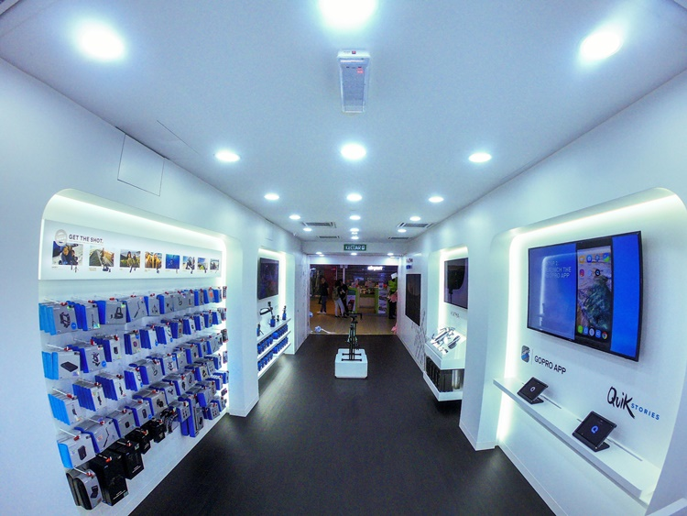
Sharper Focus
Lease previous generational cameras
Move inventory
Slowly churn out cameras
Bundle pricing
Create a subsidiary to be a lessor
Utilizing stations across retail channels
1
Enhancing leadership and oversight
2
Monetizing trapped value of older generational products
3
Streamlining the product-line for generational leap

Slide 18
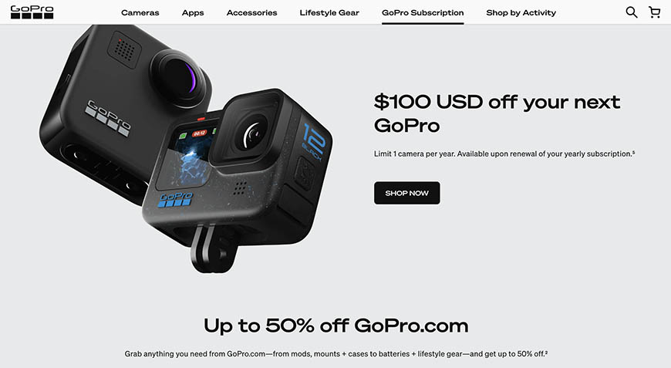
Sharper Focus
Slashed prices in half from $399 to $199 in 3 months
Increasing duration of product release period
Newer Hero product only for breakthrough tech
Utilizing technology for Dash-cam market
Refocusing Hero on action market
1
Enhancing leadership and oversight
2
Monetizing trapped value of older generational products
3
Streamlining the product-line for generational leap

Slide 19
Appendix

Slide 20
Leasing Estimates
Hero12
Assumptions
 |  | Per Week | Per Month | Per Year
Days | 1 | 7 | 30 | 360
$ per day | 20 | 10 | 5 | 0.75
Total $ | 20 | 70 | 150 | 270
 |  | 2025 | 2026 | 2027
Cameras Shipped in MM |  | 3 | 3 | 3
Leased Cameras % of total | 30% | 0.9 | 0.9 | 0.9
Plan structure
Per day | 15% | 0.135 | 0.135 | 0.135
Per week | 30% | 0.27 | 0.27 | 0.27
Per month | 40% | 0.36 | 0.36 | 0.36
Per year | 15% | 0.135 | 0.135 | 0.135
Utilization | 40%
Revenue from leasing |  | 44.82 | 53.46 | 66.42
 |  | 2025 | 2026 | 2027
Total Revenue in $MM |  | 77.814 | 92.331 | 115.389
Camera: $300
Bundle: $350

Slide 21
Appendix
Fewer and Fewer improvements YoY
GoPro Camera Model | Video Specs | Megapixels / Burst Mode | Waterproofing | Wifi & Bluetooth | Battery | Touch Display | Video Stabilisation | Protune | Voice Control | GPS | Mics | HDMI Port | Touch Zoom
Hero 12 Black | 5.3K 60 | 27.13 MP 30 fps | 33 feet 10 m Hydrophobic | Yes | 1720 mAh Removable | Yes | Hyper Smooth 6.0 | Yes | Yes | Yes | 3 | Replaced by USB-C | Yes
Hero 11 Black | 5.3K 60 | 27.13 MP 30 fps | 33 feet 10 m Hydrophobic | Yes | 1720 mAh Removable | Yes | Hyper Smooth 5.0 | Yes | Yes | Yes | 3 | Replaced by USB-C | Yes
Hero 10 Black | 5.3K 60 | 23 MP 30 fps | 33 feet 10 m Hydrophobic | Yes | 1720 mAh Removable | Yes | Hyper Smooth 4.0 | Yes | Yes | Yes | 3 | Replaced by USB-C | Yes
Hero 9 Black | 5K 30 fps 4K 60 fps | 20 MP 30 fps | 33 feet 10 m | Yes | 1720 mAh Removable | Yes | Hyper Smooth 3.0 | Yes | Yes | Yes | 3 | Replaced by USB-C | Yes
Hero 8 Black | 4K 60 fps | 12 MP 30 fps | 33 feet 10 m | Yes | 1220 mAh Removable | Yes | Hyper Smooth 2.0 | Yes | Yes | Yes | 3 | Replaced by USB-C | Yes
Max | 5.6K 30 fps | 18 MP 30 fps | 16 feet 5 m | Yes | 1600 mAh Removable | Yes | Max Hyper Smooth | Yes | Yes | Yes | 6 | Comes with USB-C | No
Hero 7 Black | 4K 60 fps | 12 MP 30 fps | 33 feet 10 m | Yes | 1220 mAh Removable | Yes | Hyper Smooth | Yes | Yes | Yes | 3 | Yes | Yes
Hero 7 Silver | 4K 30 fps | 10 MP 15 fps | 33 feet 10 m | Yes | 1220 mAh Built-in | Yes | Standard | No | Yes | Yes | 2 | No | Yes
Hero 7 White | 1440 60 fps | 10 MP 15 fps | 33 feet 10 m | Yes | 1220 mAh Built-in | Yes | Standard | No | Yes | Yes | 2 | No | Yes
Fusion | 5.2K 30 fps | 18 MP 30 fps | 16 feet 5 m | Yes | 2620 mAh Removable | No | Advanced | Yes | Yes | Yes | 4 | Yes | No
Hero 6 Black | 4K 60 fps 4K 30 fps | 12 MP 30 fps | 33 feet 10 m | Yes | 1220 mAh Removable | LCD Touch | Advanced | Yes | Yes | Yes | 3 | Yes | Yes
Hero 5 Black | 4K 30 fps | 12 MP 30 fps | 33 feet 10 m | Yes | 1220 mAh Removable | Yes | Yes | Yes | Yes | Yes | 3 | Yes | Yes
Hero 5 Session | 4K 30 fps | 10 MP 30 fps | 33 feet 10 m | Yes | 1000 mAh Built-in | No | Yes | Yes | Yes | Yes | 2 | No | No

Slide 22
Income Statement
 | Dec-21 | Dec-22 | Dec-23 | Q1 2024 | Q2 2024 | Q3 2024E | Q4 2024E | Dec-2024E | Dec-2025E | Dec-2026E | Dec-2027E
No. of Units Sold in MM | 3.15 | 2.96 | 2.98 | 0.39 | 0.58 | 0.72 | 0.82 | 2.51 | 3 | 3 | 3
Average Selling Price | 369.00 | 389.00 | 337.00 | 337.00 | 337.00 | 333.00 | 326.00 | 300.00 | 300 | 290 | 285
Revenues
Revenues | 1161.08 | 1093.54 | 1005.46 | 155.46 | 186.20 | 239.76 | 267.32 | 848.74 | 900.00 | 870.00 | 855.00
Lease |  |  |  |  |  |  |  |  | 77.81 | 92.33 | 115.39
COGS
COGS | (668.78) | (678.14) | (675.73) | (100.66) | (127.48) | (158.24) | (183.02) | (569.40) | (586.69) | (577.40) | (582.23)
Value-saved |  |  |  |  |  |  |  |  | 11.73 | 11.55 | 11.64
Total COGS | (668.78) | (678.14) | (675.73) | (100.66) | (127.48) | (158.24) | (183.02) | (569.40) | (574.95) | (565.85) | (570.59)
Gross Profit | 492.31 | 415.40 | 329.73 | 54.80 | 58.72 | 81.52 | 84.30 | 279.34 | 402.86 | 396.48 | 399.80
Operating Expenses
Selling, General & Admin | 222.40 | 227.99 | 233.35 | 49.84 | 56.29 | 56.00 | 56.00 | 218.13 | 244.45 | 230.96 | 223.19
Research & Development | 141.49 | 139.89 | 165.69 | 44.61 | 46.93 | 49.48 | 55.17 | 196.20 | 166.23 | 153.97 | 145.56
Value-saved |  |  |  |  |  |  |  |  | (16.62) | (15.40) | (14.56)
EBITDA | 128.42 | 47.53 | (69.30) | (39.65) | (44.50) | (23.96) | (26.88) | (134.98) | 8.80 | 26.95 | 45.61
EBT | 90 | 34 | (68) | (40) | (46) | (26) | (29) | (142) | 3 | 22 | 40
Taxes | 281 | (6) | 15 | (298) | (1) | (10) | (10) | (320) | 0 | 0 | 0
Net Income from Continuing Operations | 371 | 29 | (53) | (339) | (47) | (36) | (39) | (461) | 3 | 22 | 40
Profit Margin % | 32.0% | 2.6% | -5.3% | -217.8% | -25.4% | -15.0% | -14.6% | -54.3% | 0.4% | 2.2% | 4.1%

Slide 23
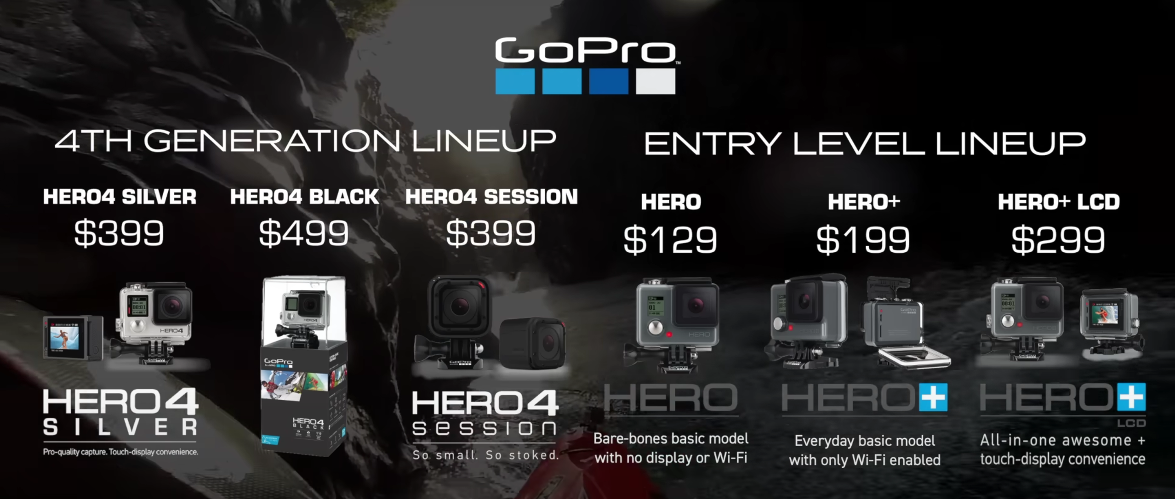
Appendix
Choice Overload with 6 SKUs at the same time

Slide 24
Appendix
Name | Position | Year | Salary | Stock Awards | Option Awards | Non-Equity Incentive Plan Compensation | All Other Compensation | Total
Nicholas Woodman | Chief Executive Officer | 2023 | 850,000 | 4,239,108 | 440,960 | 586,500 | 535 | 5,676,143
 |  | 2022 | 850,000 | 3,615,355 | 290,055 | 325,605 | 184 | 5,110,365
 |  | 2021 | 850,000 | 3,121,199 | 187,410 | 503,700 | 166 | 3,301,942
Brian McGee | Executive Vice President, Chief Financial Officer and Chief Operating Officer | 2023 | 730,000 | 2,067,858 | 220,888 | 268,146 | 384 | 2,312,571
 |  | 2022 | 700,000 | 1,335,720 | 187,410 | 577,875 | 184 | 1,354,989
 |  | 2021 | 575,000 | 869,475 | 156,183 | 253,058 | 166 | 1,854,882
Eve Saltman | Senior Vice President, Corporate & Business Development, Chief Legal Officer, Secretary and Chief Compliance Officer | 2023 | 489,000 | 878,835 | 165,362 | 135,030 | 461 | 1,668,688
 |  | 2022 | 470,000 | 567,684 |  | 345,182 | 184 | 1,382,050
 |  | 2021 | 448,895 | 659,979 |  | 260,066 | 166 | 1,368,106
Dean Jahnke | Senior Vice President, Global Sales & Channel Marketing | 2023 | 449,500 | 878,835 |  | 112,194 | 434 | 1,440,963
 |  | 2022 | 432,000 | 567,684 |  | 409,019 | 184 | 1,408,887
 |  | 2021 | 412,000 | 468,177 |  | 117,793 | 1,366 | 999,336
Kevin Hinge | Senior Vice President, Chief Supply Chain Officer | 2023 | 165,577 | 500,894 |  | 1,194,233 | 184 | 1,860,888
 |  | 2022 | 410,000 | 1,038,077 |  | 117,793 | 184 | 1,566,054
 |  | 2021 | 1,000 | 267,223 |  | 1,149,079 | 184 | 1,417,486

Slide 25
Quotes by Nick Woodman
"It's become clear that our customers are expecting either a significant upgrade every year or a significant discount in the previous year's model - and this group is larger than previously understood. This may seem obvious but we didn’t understand the repeat nature of our customer. We’ve learned that not everybody is upgrading every year and people are in different phases of their upgrade cycle.
"It's important that we have something to really wow our customers and compel them to update or become a new customer. We also recognize that we can't leave our older products out at their original pricing. That's what really hurt sales when we left our $299 and $399 cameras out for a second year in a row at the same prices. Perhaps, more importantly, we don't have any significant direct competition to help us.“
"AT&T has Verizon and Ford has Chevy who will take market share from them when they make a product or pricing mistake. In GoPro's case, we have competition but we don't have a direct competitor to help us benchmark our business. We've had to learn about our market all on our own."

